Slide 2
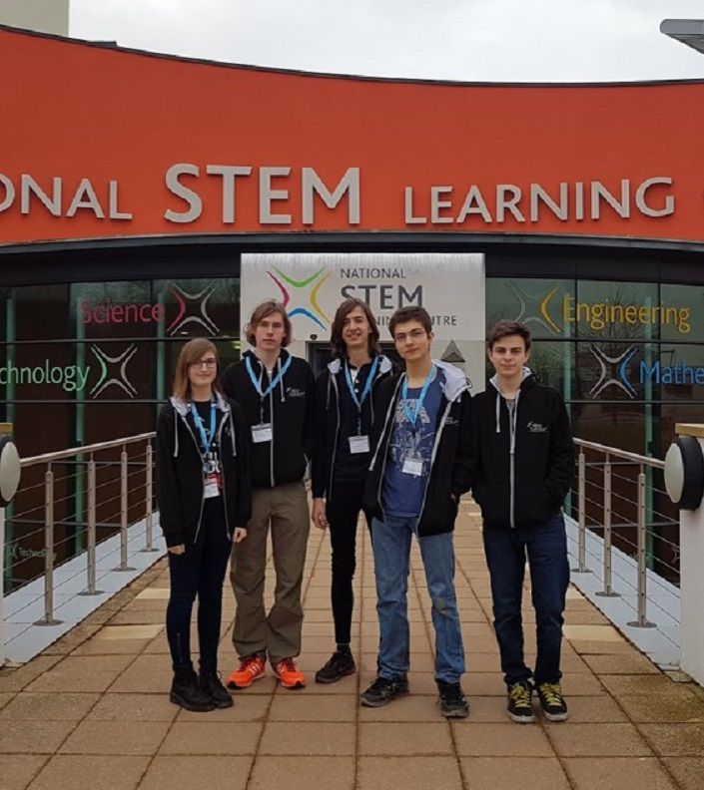
Our team
George Watson’s College, Edinburgh
16-18 years old
Calder Maclean | Software
Charles Cameron | Electrical; Mechanical; Outreach
Jack Hargreaves | Software
Kaveh Pezeshki | Team Leader; Software; Electrical
Morven Pennie | Graphics; Outreach; Mechanical
Pedro Guimaraes | Mechanical

Slide 3
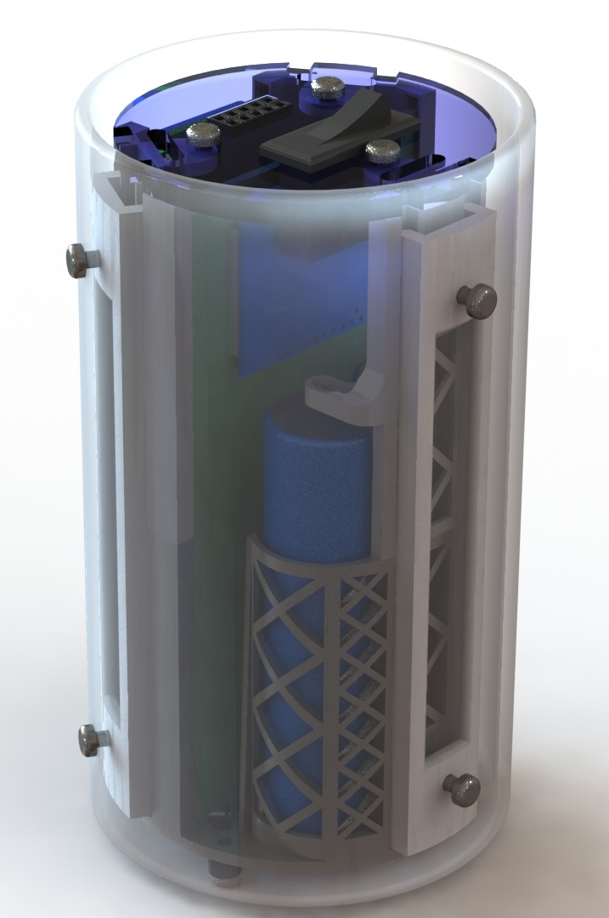
Mission objectives
Monitor atmospheric variables
Create temperature map of surface below CanSat
Accurate and reliable sensor operation
Stable software and data processing
Sufficient mechanical characteristics

Slide 4

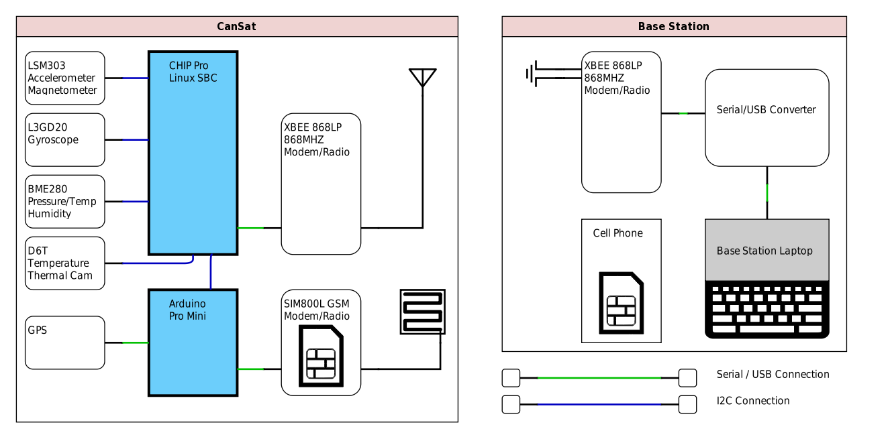

Slide 5

Motion tracking

Slide 6
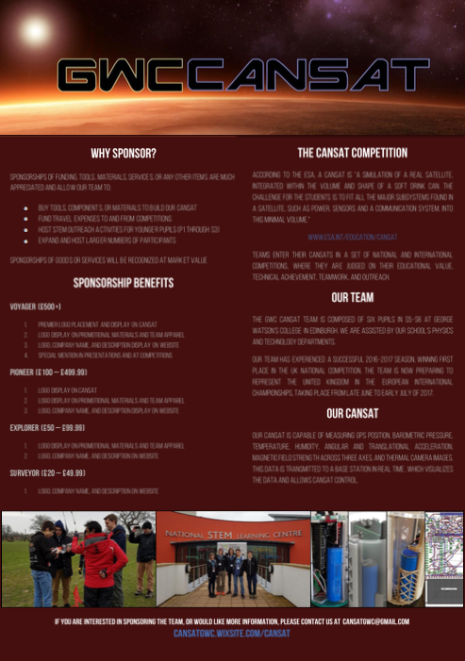
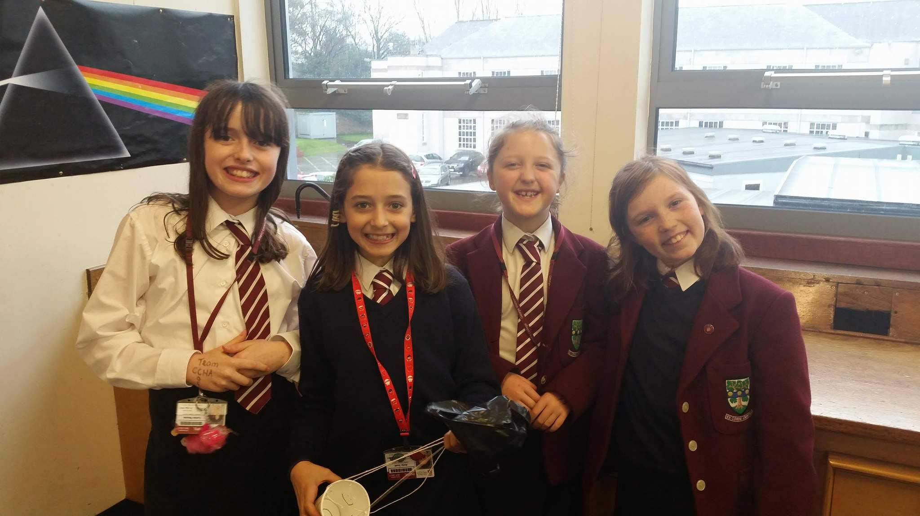
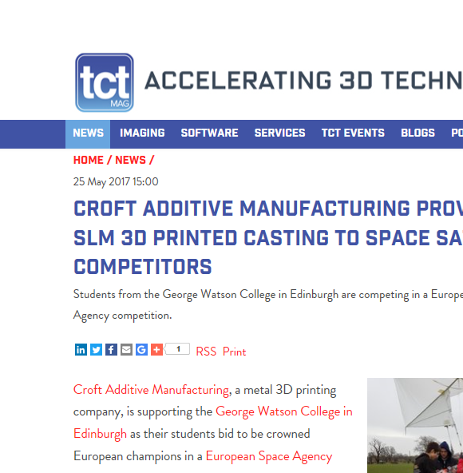
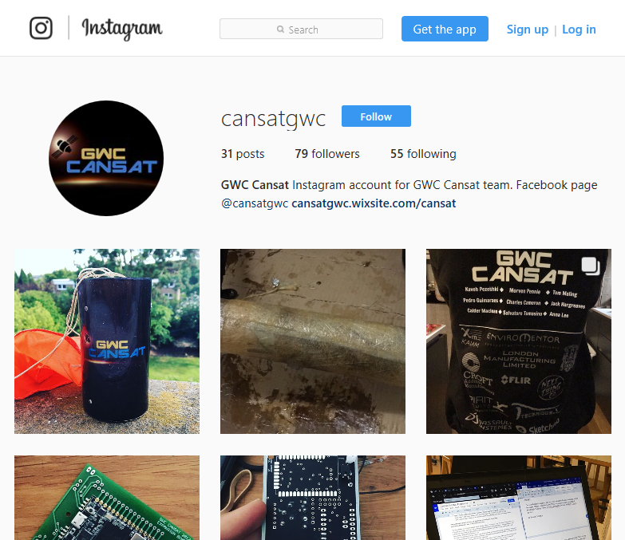
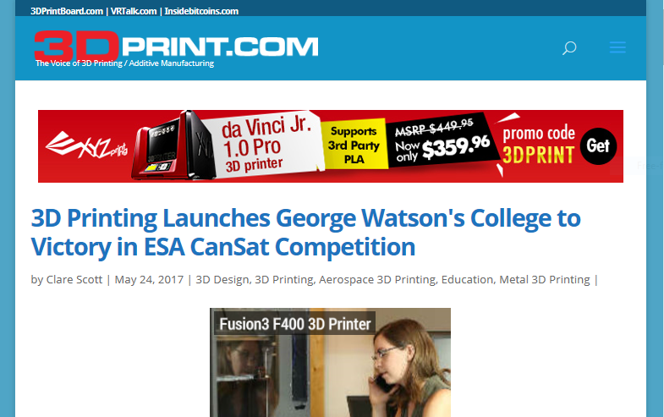
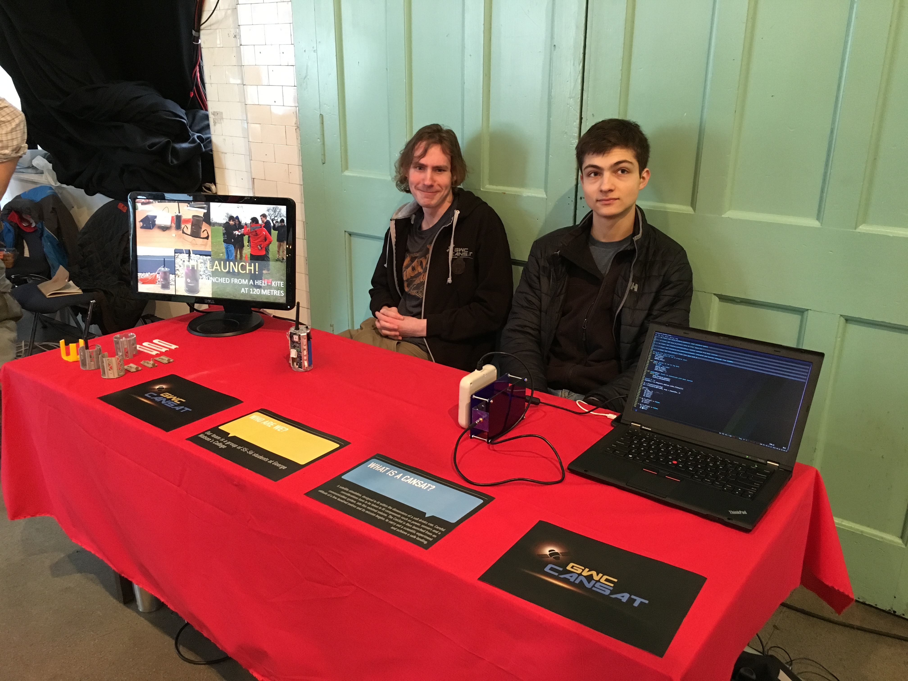
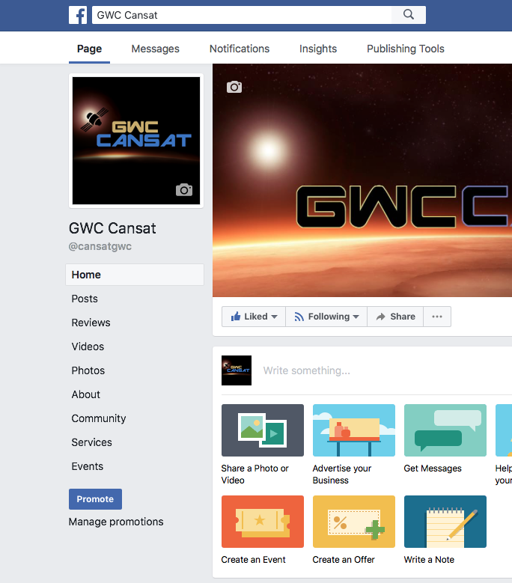
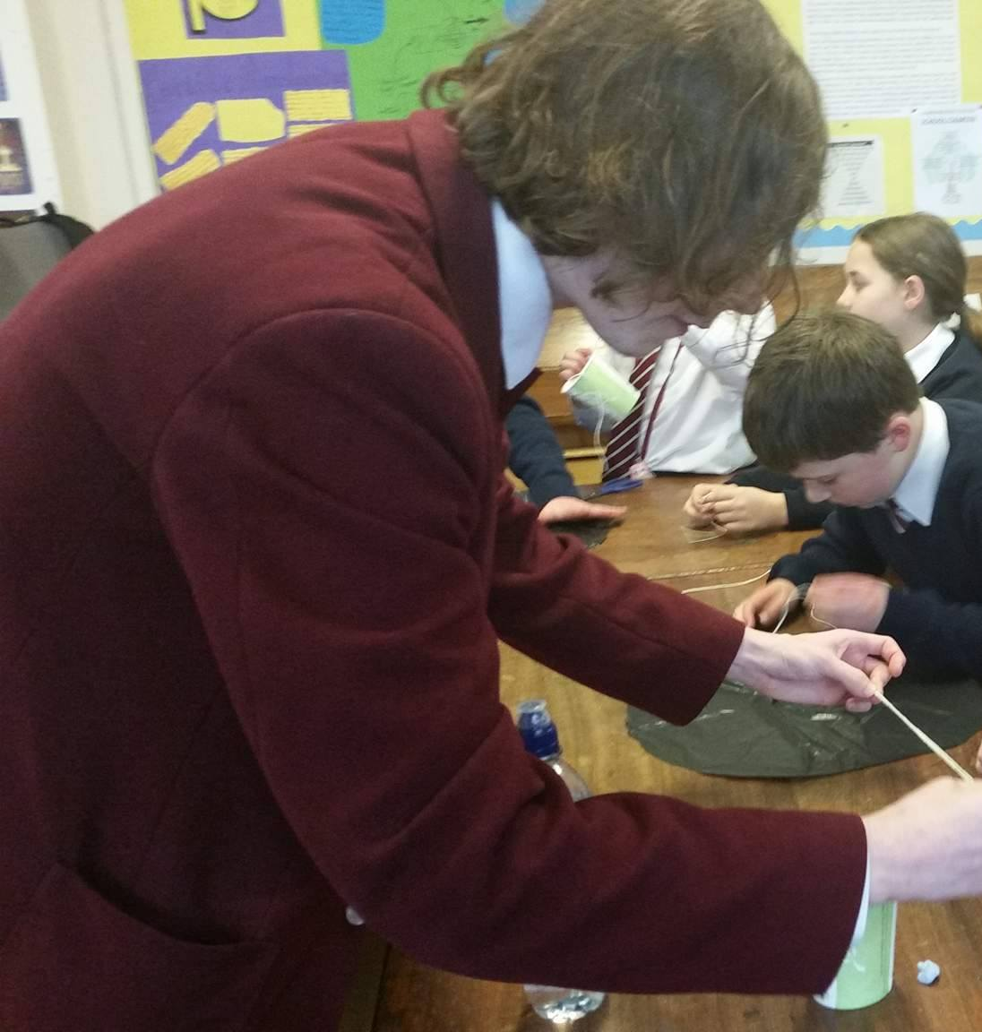
outreach
Social Media and Website
Interactive Workshops
Event Presence
Advertisement Materials
Substantial press received

Slide 7
Fin

Slide 8
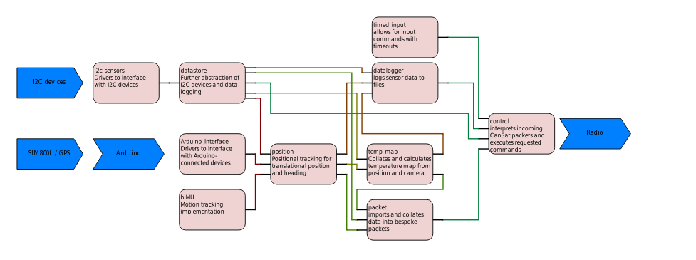
CANSAT PROGRAMMING
Python and C++
2700+ lines of code
Modular
Feature-Packed
https://github.com/Arcturus314/cansat2017

Slide 9
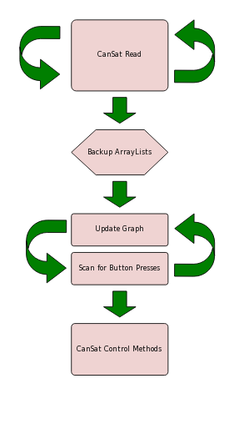
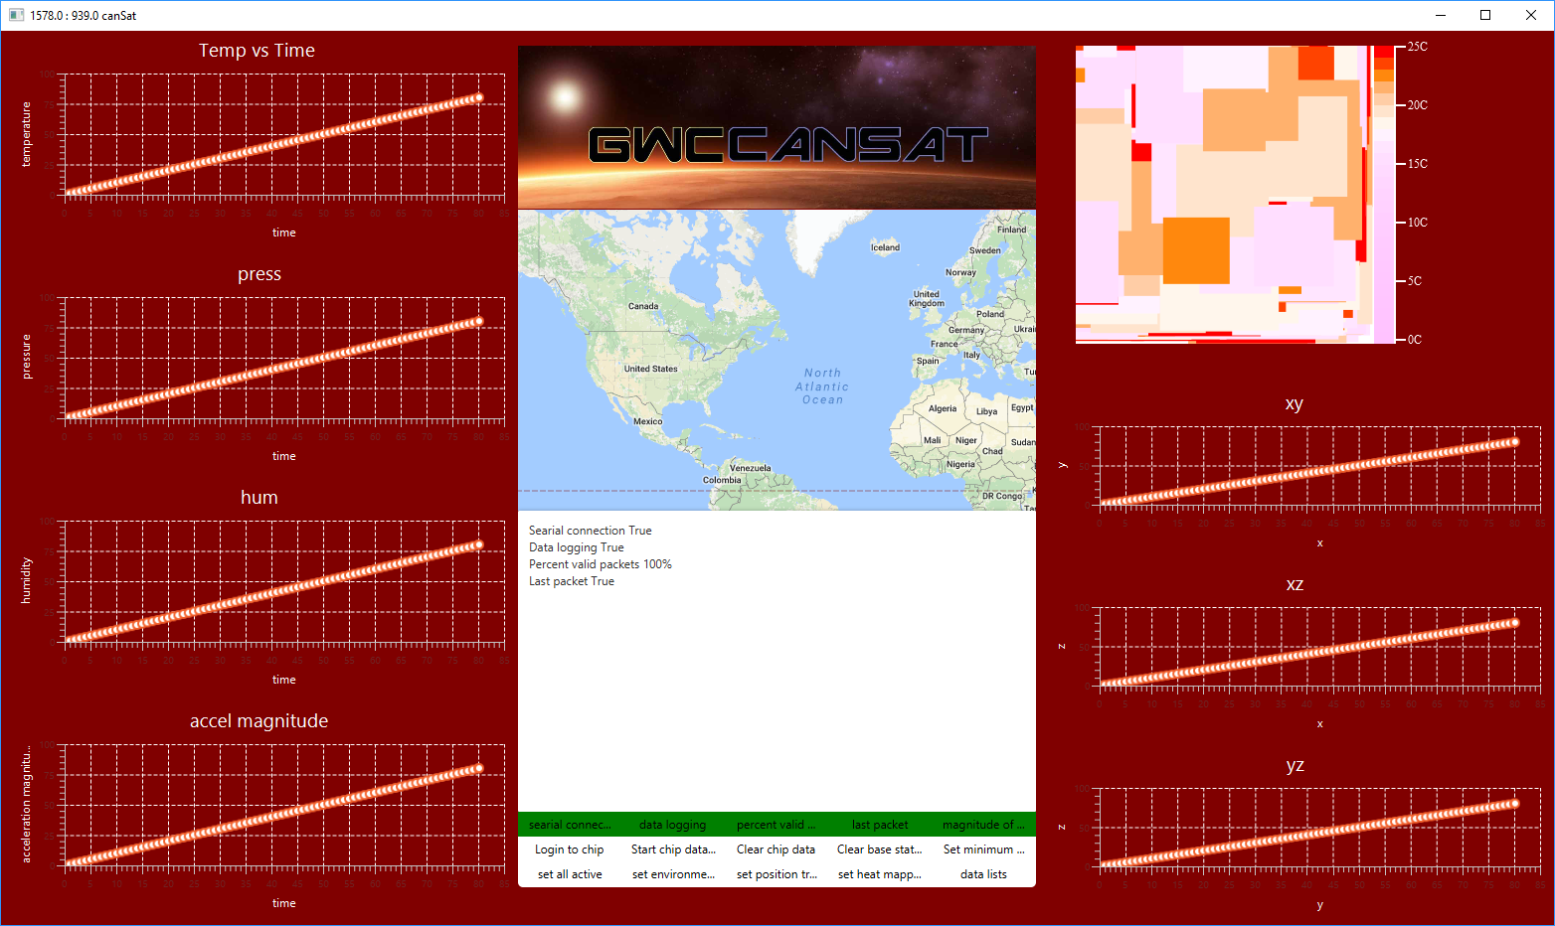
Base station
Java / JavaFX
Real-Time Graphing
CanSat Control
https://github.com/Arcturus314/cansat2017

Slide 10

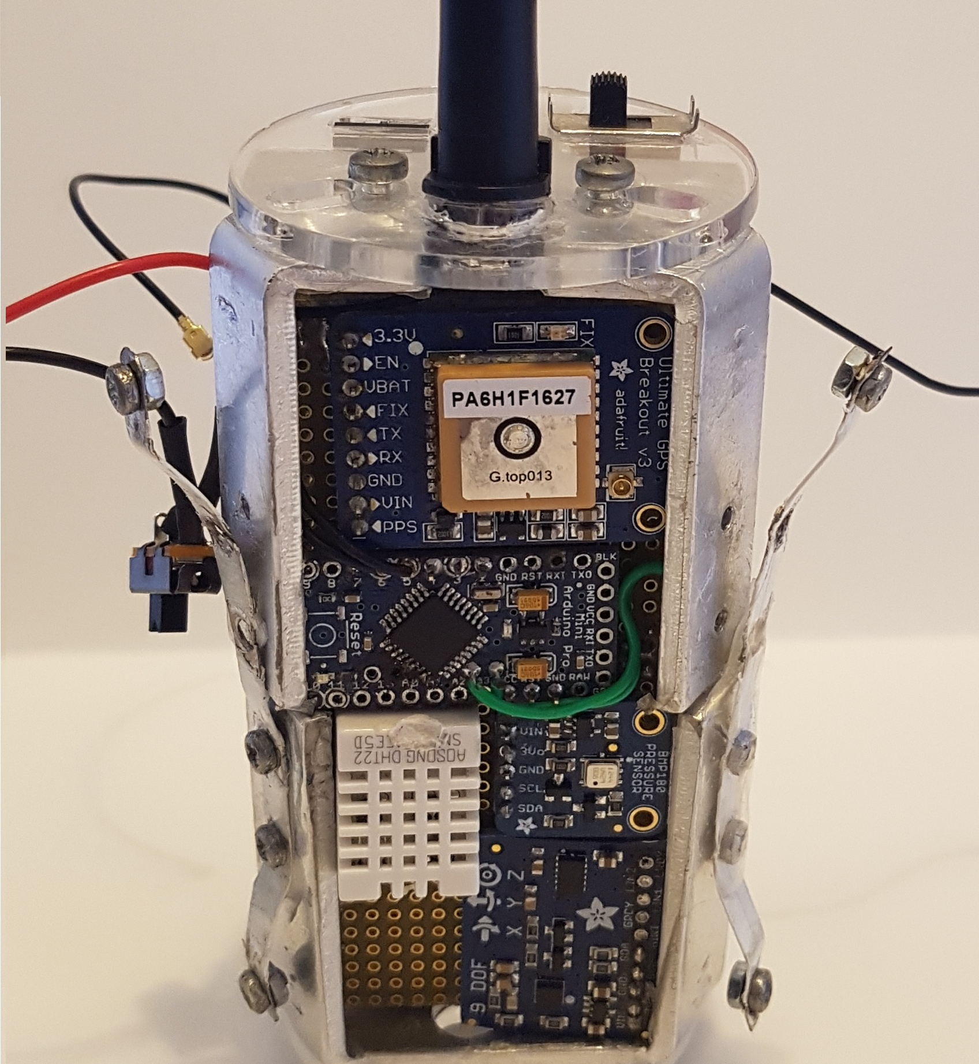
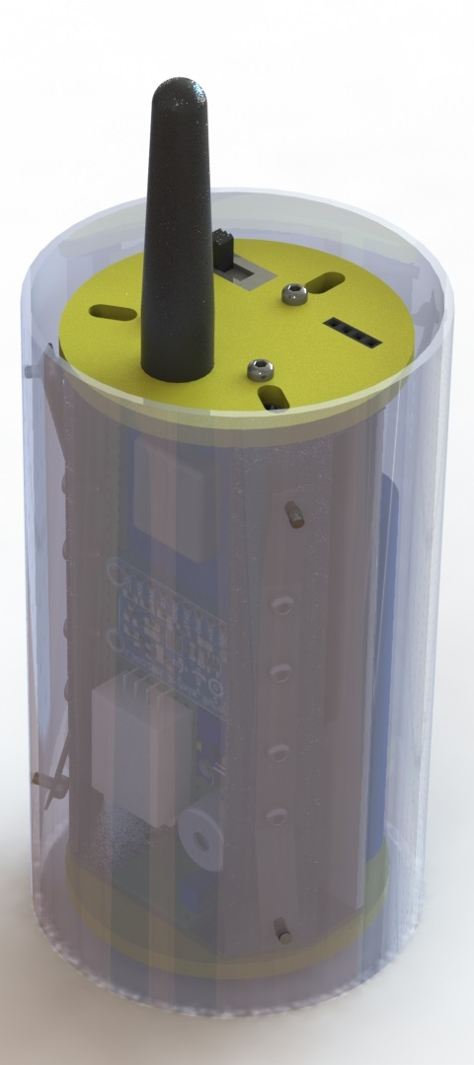
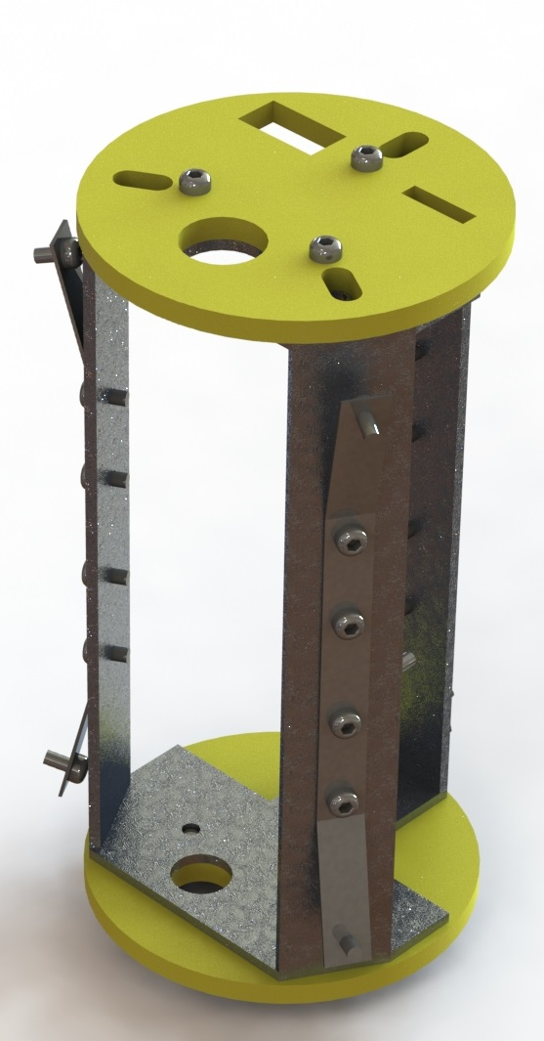
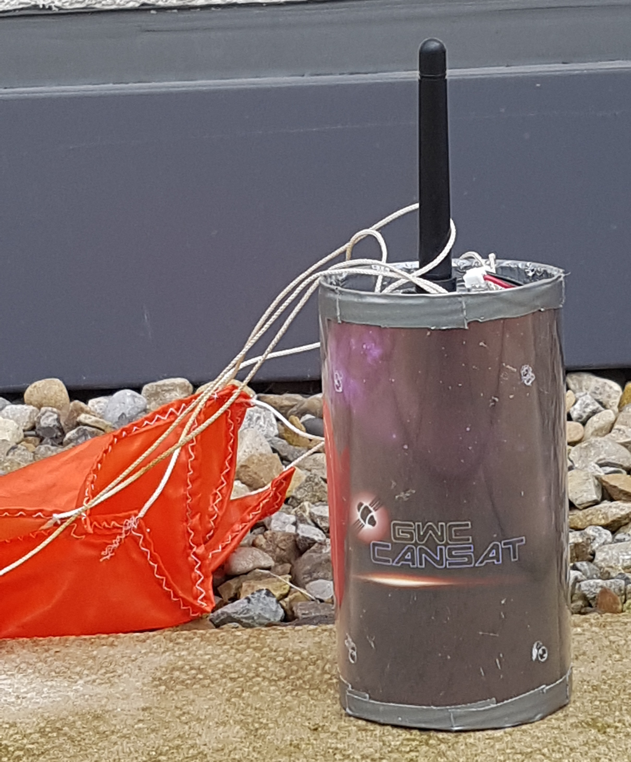
Prototype cansat
Larger SBC
Hand-Wired
Discrete Sensors
Bent aluminum and laser-cut acrylic frame
Fiberglass shell

Slide 11
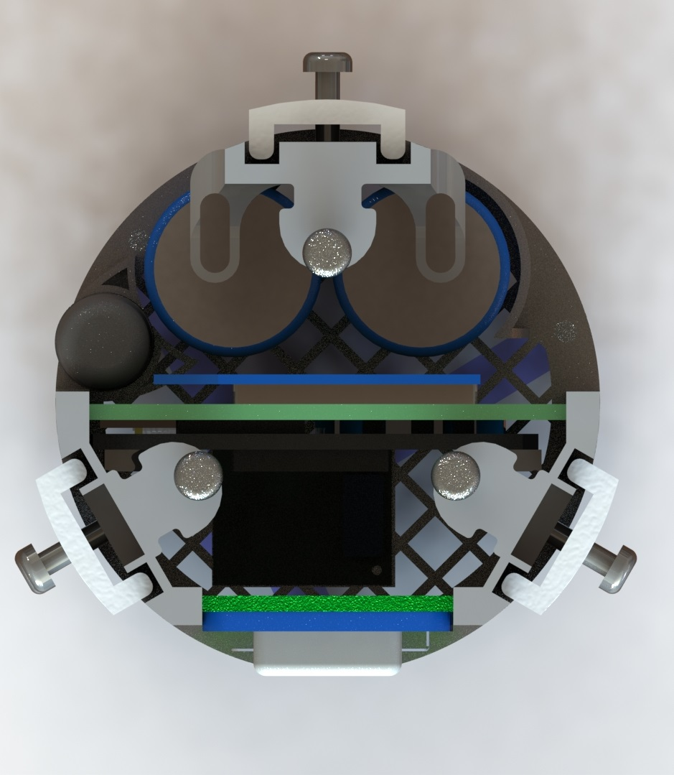
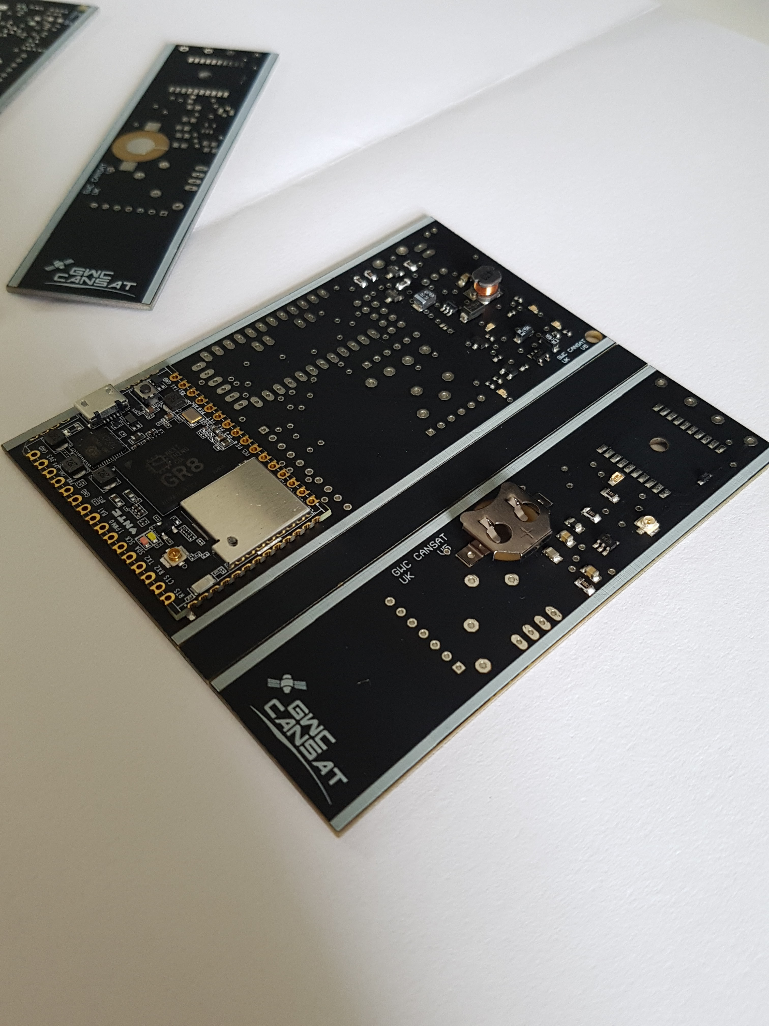
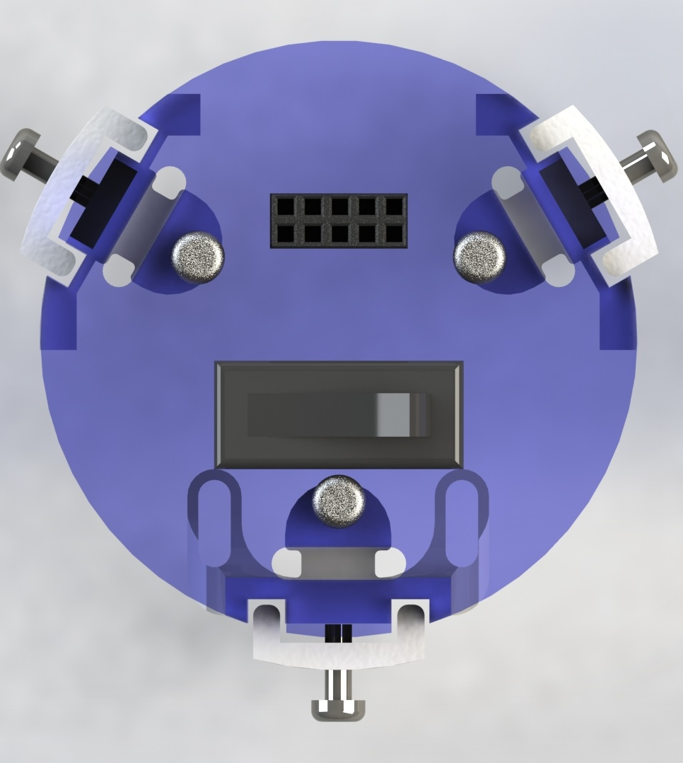
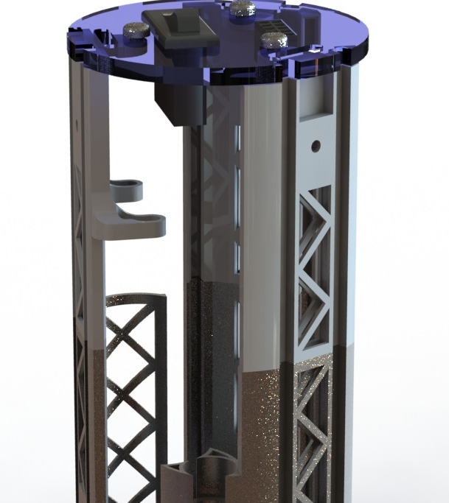
Final cansat
New SBC and smaller sensors
3D printed steel and nylon frame
Custom PCBs
Rewritten software

Slide 12
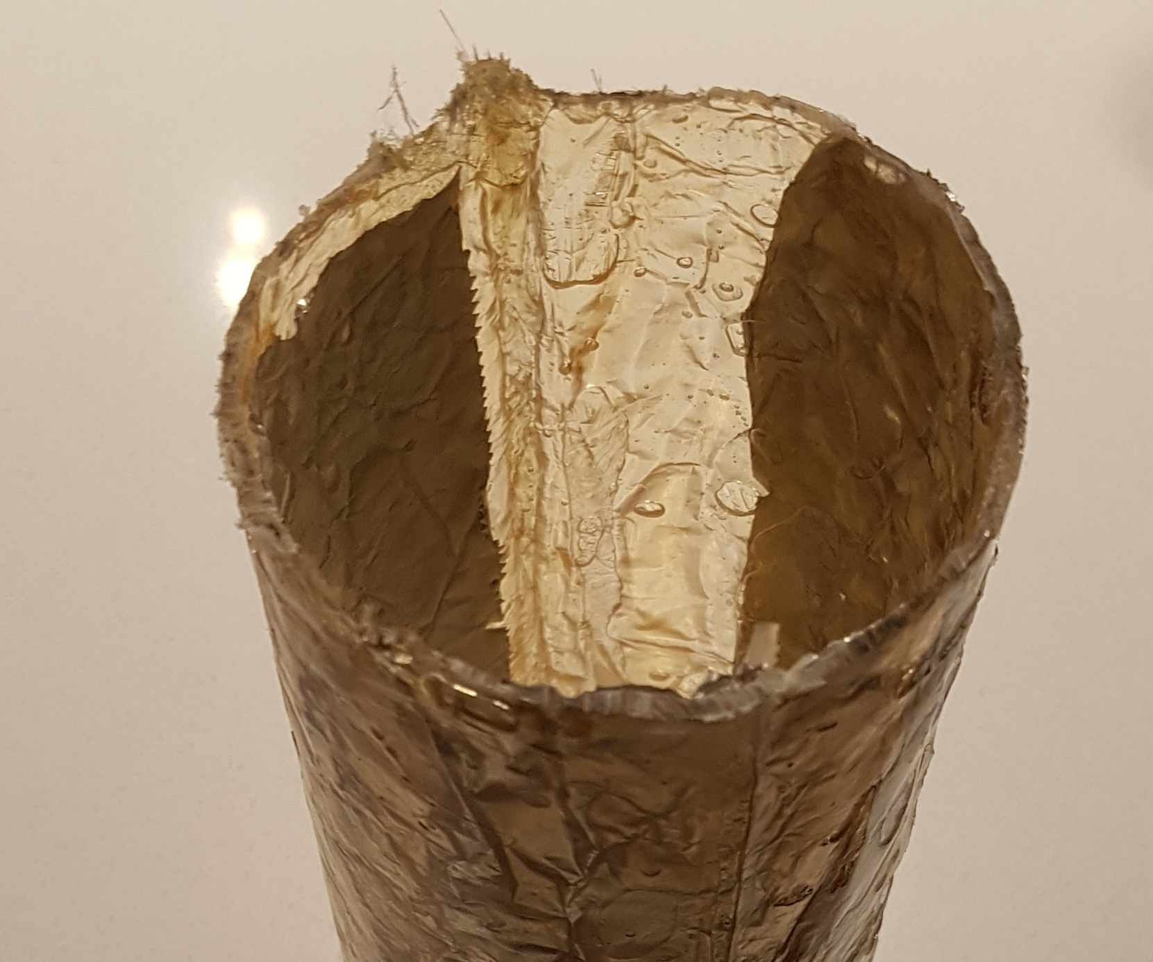
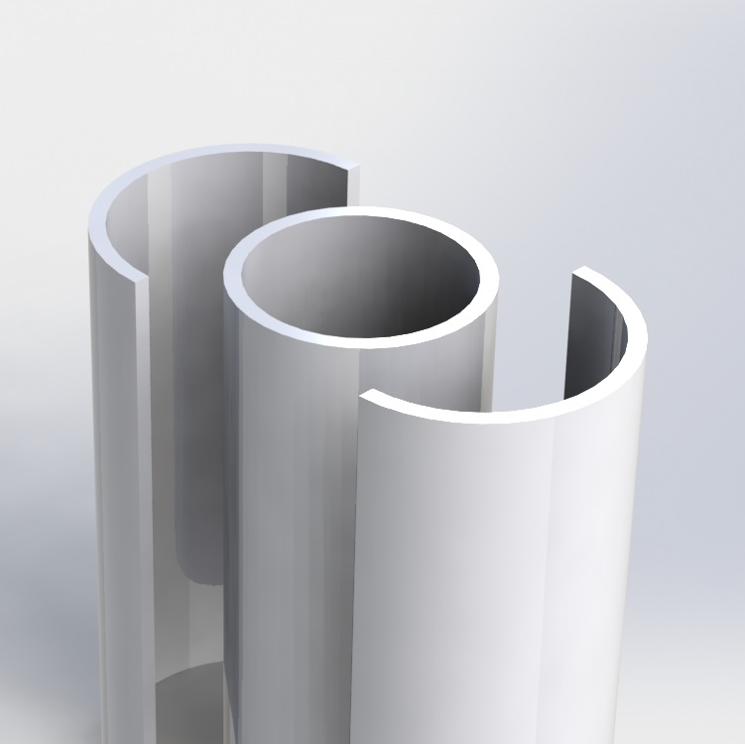
Outer shell
Fiberglass over PLA mold
1-3mm thick
Covered with printed plastic wrap

Slide 13
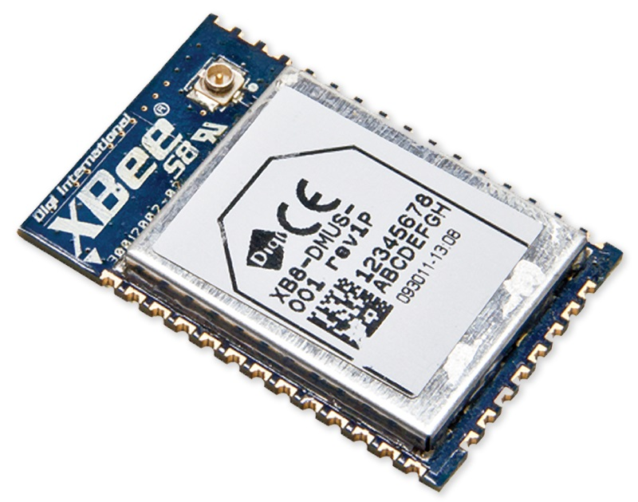
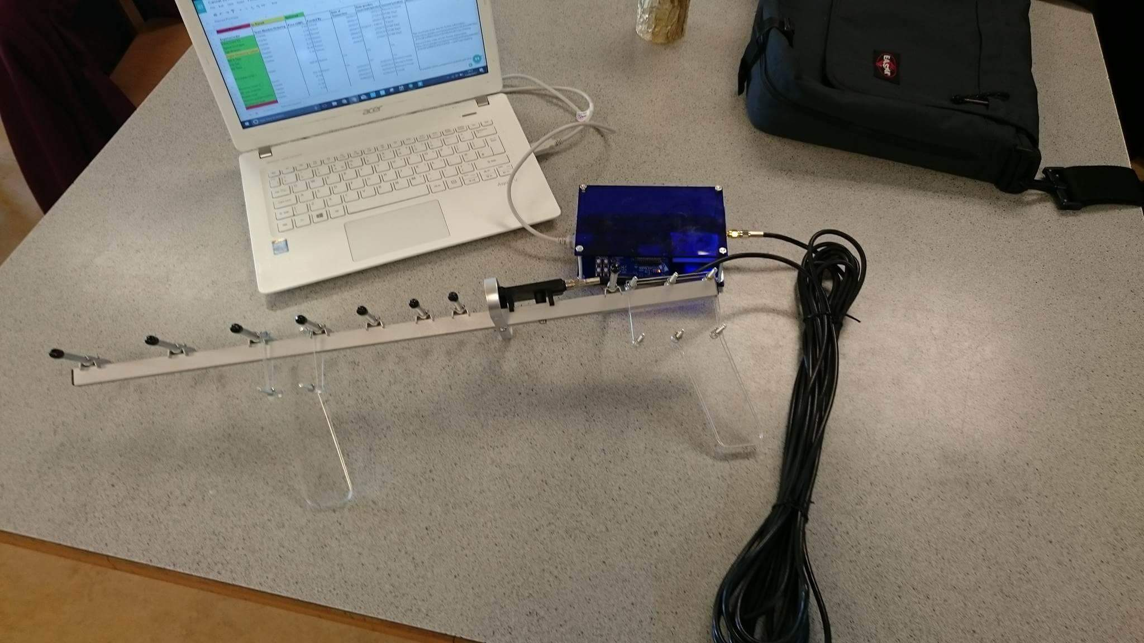
Radio
XBEE 868LP For Europe
5km rated range
10kbps transfer speed
Mesh networking
CanSat: u.fl duck antenna
Base Station: Yagi-Uda 11dBm

Slide 14
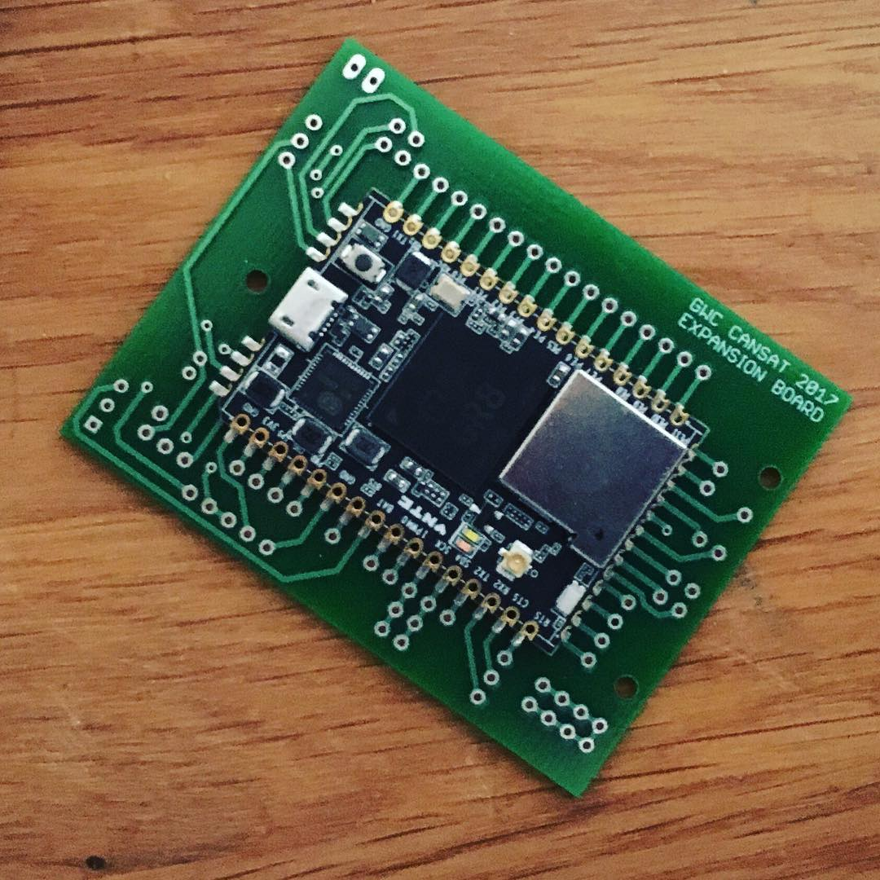
Expansion
Multi-node mesh network
Interconnected sensor arrays
Real-world applications
Expansion board with:
CHIP Pro
Li-Ion Battery
XBEE
3.3V Sensors

